Slide 1
Therapeutic Drugs 1
Dr.Nathasha Luke

Slide 2
Objectives
Principals of management of a patient with drug overdose/poisoning
Specific management of paracetamol overdose

Slide 3
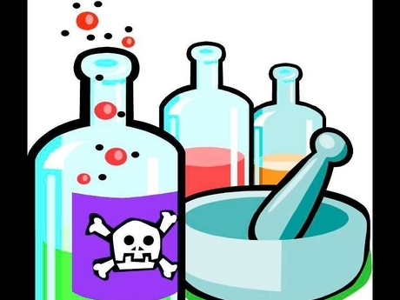
Acute poisoning
A medical emergency
A common cause of morbidity and mortality

Slide 4
Case 1
Mangala, a 17 year old girl is brought to the casualty ward by her parents claiming to have taken 25 tablets of paracetamol after an argument with her parents .
1.What are the important aspects in history taking?
2.What are the important findings in examination you should elicit?
3.What are the useful investigations in managing a patient with poisoning ?
3.What would be the basic principals of management?

Slide 5
History
What agent? - single/multiple
Amount
What time?
Circumstances – suicidal/ accidential /homicidal

Slide 6
Examination-Poisoning
Level of consciousness
Respiratory rate/depth
Temperature
Pulse/Blood pressure
Pupils
Tone
Reflexes

Slide 7
Investigations
Measurement of blood levels of specific substances
-paracetamol
-salicylate
-lithium
Toxicological screening of urine and blood

Slide 8
Other investigations
Arterial blood gas –acid base imbalance
Prothrombin time- paracetamol/oral anticoagulants
Transaminases
Serum electrolytes
Serum creatinine
ECG
FBC
CXR

Slide 9
Task
Name 2 drugs known to cause hypokalaemia in overdose
What are the ECG changes expected in toxicity with
-TCA
-Digoxin

Slide 10
Principals of management
Resuscitation and assessment
Specific measures
Anticipate and manage complications
Psychiatric assessment /support
Medico legal duties
Majority will not need specific interventions

Slide 11
Management- Resuscitation
Airway
Breathing
Circulation
GCS
Blood sugar

Slide 12
Management –Specific management
Decrease absorption -------gastrointestinal decontamination
Gastric lavage
Adsorbents –activated charcoal/Fullers earth
- Whole bowel irrigation
Increasing elimination
- Alkaline diuresis
Haemodialysis/peritoneal dialysis
Antidotes

Slide 13
Decreasing absorption of toxic substance –gastrointestinal decontamination
Consider once patient is stabilized
Only in patients able to protect their airway and who have taken potentially dangerous amount of a poison
Avoid forced emesis

Slide 14
Gastric lavage
Left lateral head down position
Pass NG tube- check positioning
0.9 % NaCl in children/ adults – 0.9% NaCl or water

Slide 15
Gastric lavage
Only those who have
-taken life threatening amount of a poison
-presenting within 1 -2 hours of ingestion
-protected airway –conscious or intubated
Use with close monitoring by a doctor/by trained staff
Risks of sudden death/aspiration pneumonia/ electrolyte imbalances

Slide 16
Gastric lavage
Contraindications
- uncooperative patient
- unable to protect airway
Clinically unstable
Corrosive ingestions –acids/alkali
Petroleum products – kerosine
Known oesophageal disease
Taken harmless substance or small quantities

Slide 17
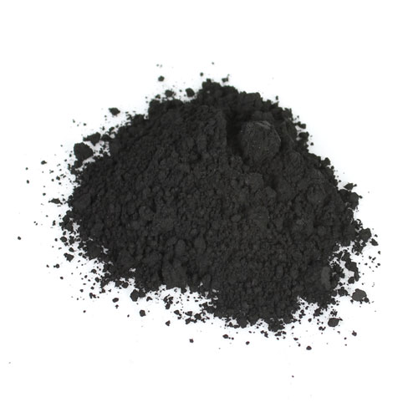
Activated charcoal
Adsorption of poisons to activated charcoal can reduce absorption
Dose- 1g/kg suspended in 4ml per gram- adults 50g in 200ml –orally
Most useful with in 1-2 h of ingestion
Not effective for – alcohol/glycol/acid /alkali/iron/lithium
Notes:
Upto 4 h if taken sustained release preparation -theophillin

Slide 18
Multiple dose activated charcoal therapy
Useful for certain agents by interrupting enteroenteric or enterohepatic circulation.
Ex-
Also useful for controlled release preparations and oleander seeds.

Slide 19
Management –Specific management
Decrease absorption -------gastrointestinal decontamination
Gastric lavage
Adsorbents –activated charcoal/Fullers earth
- Whole bowel irrigation
Increasing elimination
- Alkaline diuresis –aspirin
Haemodialysis – aspirin/lithium/methanol
Antidotes

Slide 20
Antidotes
Antidote is a substance that counteract the effects of a poison
Poison /drug | Antidote
Paracetamol | N-acetylcystene,Methionine
Beta blockers | Glucagon
Digoxin | Digoxin specific antibody fragments
Iron | Desferrioxamine
Warfarin | Vitamin K
Methanol | Ethanol
Heparin | Protamine sulfate
Organophospate | Pralidoxime
Cyanide | Amyl nitrate

Slide 21
Case 1
Mangala, a 17 year old girl is brought to the casualty ward by her parents claiming to have taken 25 tablets of paracetamol after an argument with her parents .
1.What are the important aspects in history taking?
2.What are the important findings in examination you should elicit?
3.What are the useful investigations in managing a patient with poisoning ?
3.What would be the basic principals of management?

Slide 22
Case 1
On further questioning the patient reveals that the tablets were taken at 1 pm and the time when the doctor sees the patient is 7.30pm.
-
-Will you consider gastric lavage for this patient?
-Will you consider activated charcoal for this patient?
-Does this patient need an antidote ?

Slide 23
Paracetamol overdose
Most widely used over the counter drug in Sri Lanka
Responsible for most cases of drug induced deliberate self harm in the country.
Toxicity is mainly by hepatic injury

Slide 24
Pathophysiology-Normal metabolism
Paracetamol
Glucouronide and sulphate
Excreted unchanged
NAPQI
TOXIC
80-90%
Conjugation
Oxidation
CYP 450
5-10%
5%
Converted to non toxic substance by glutathione

Slide 25
Pathophysiology-Overdose
Paracetamol
Glucouronide and sulphate
Excreted unchanged -----RENAL FAILURE
NAPQI
TOXIC
Saturated
Activated
Glutathione depleted
X
Accumulates causing damage

Slide 26
What is the therapeutic dose of paracetamol?
Adult dose -1g /6 hourly
Pediatric dose – 15mg/kg /dose ------ maximum recommended ---100mg /kg /d
What are the different dosage forms of paracetamol available?

Slide 27
MCQ
Which of the above would be a considered as toxic dose of paracetamol taken as a single ingestion by an adult?
ingestion of 2 500mg tablets of paracetamol
Ingestion of 20 5OOmg tablets of paracetamol
Ingestion of 100 500mg tablets of paracetamol

Slide 28
Toxic dose of paracetamol
Single dose of
10g
OR
≥ 200 mg/kg
Repeated doses ≥ 200 mg/kg/d
Notes:
Repeated doses during more than 8h

Slide 29
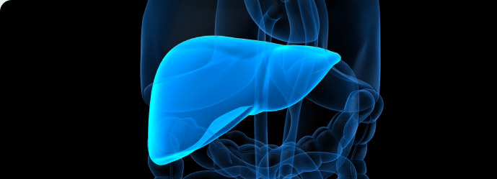
Paracetamol overdose –Clinical picture
0-24 h : mostly asymptomatic
24-72h : after a latent period hepatotoxicity develops
asymptomatic except RHC tenderness
elevated transaminases
72-96h:Liver faliure-bleeding/encepalopathy
ATN
acidosis
pancreatitis/myocarditis/DIC
96h-2 weeks : recovery /death

Slide 30
Investigations
Paracetamol levels
-Useful guide to therapy
-Useful only if done within 4-16h of ingestion.
-Rumack-Mathew normogram is used for interpretation of results
-Limitation: in local setting not readily available

Slide 31
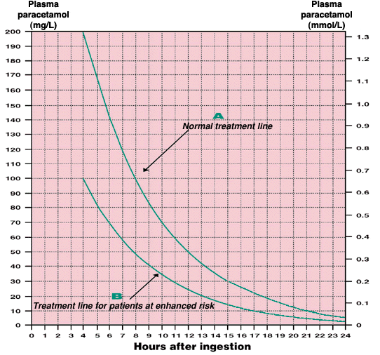
Normogram

Slide 32
High risk categories

Slide 33
Investigations
Paracetamol levels
-Useful guide to therapy
-Useful only if done within 4-16h of ingestion.
-Rumack-Mathew normogram is used for interpretation of results
-Limitation: in local setting not readily available
Other investigations - Transaminases/INR/Electrolytes /Renal function tests

Slide 34
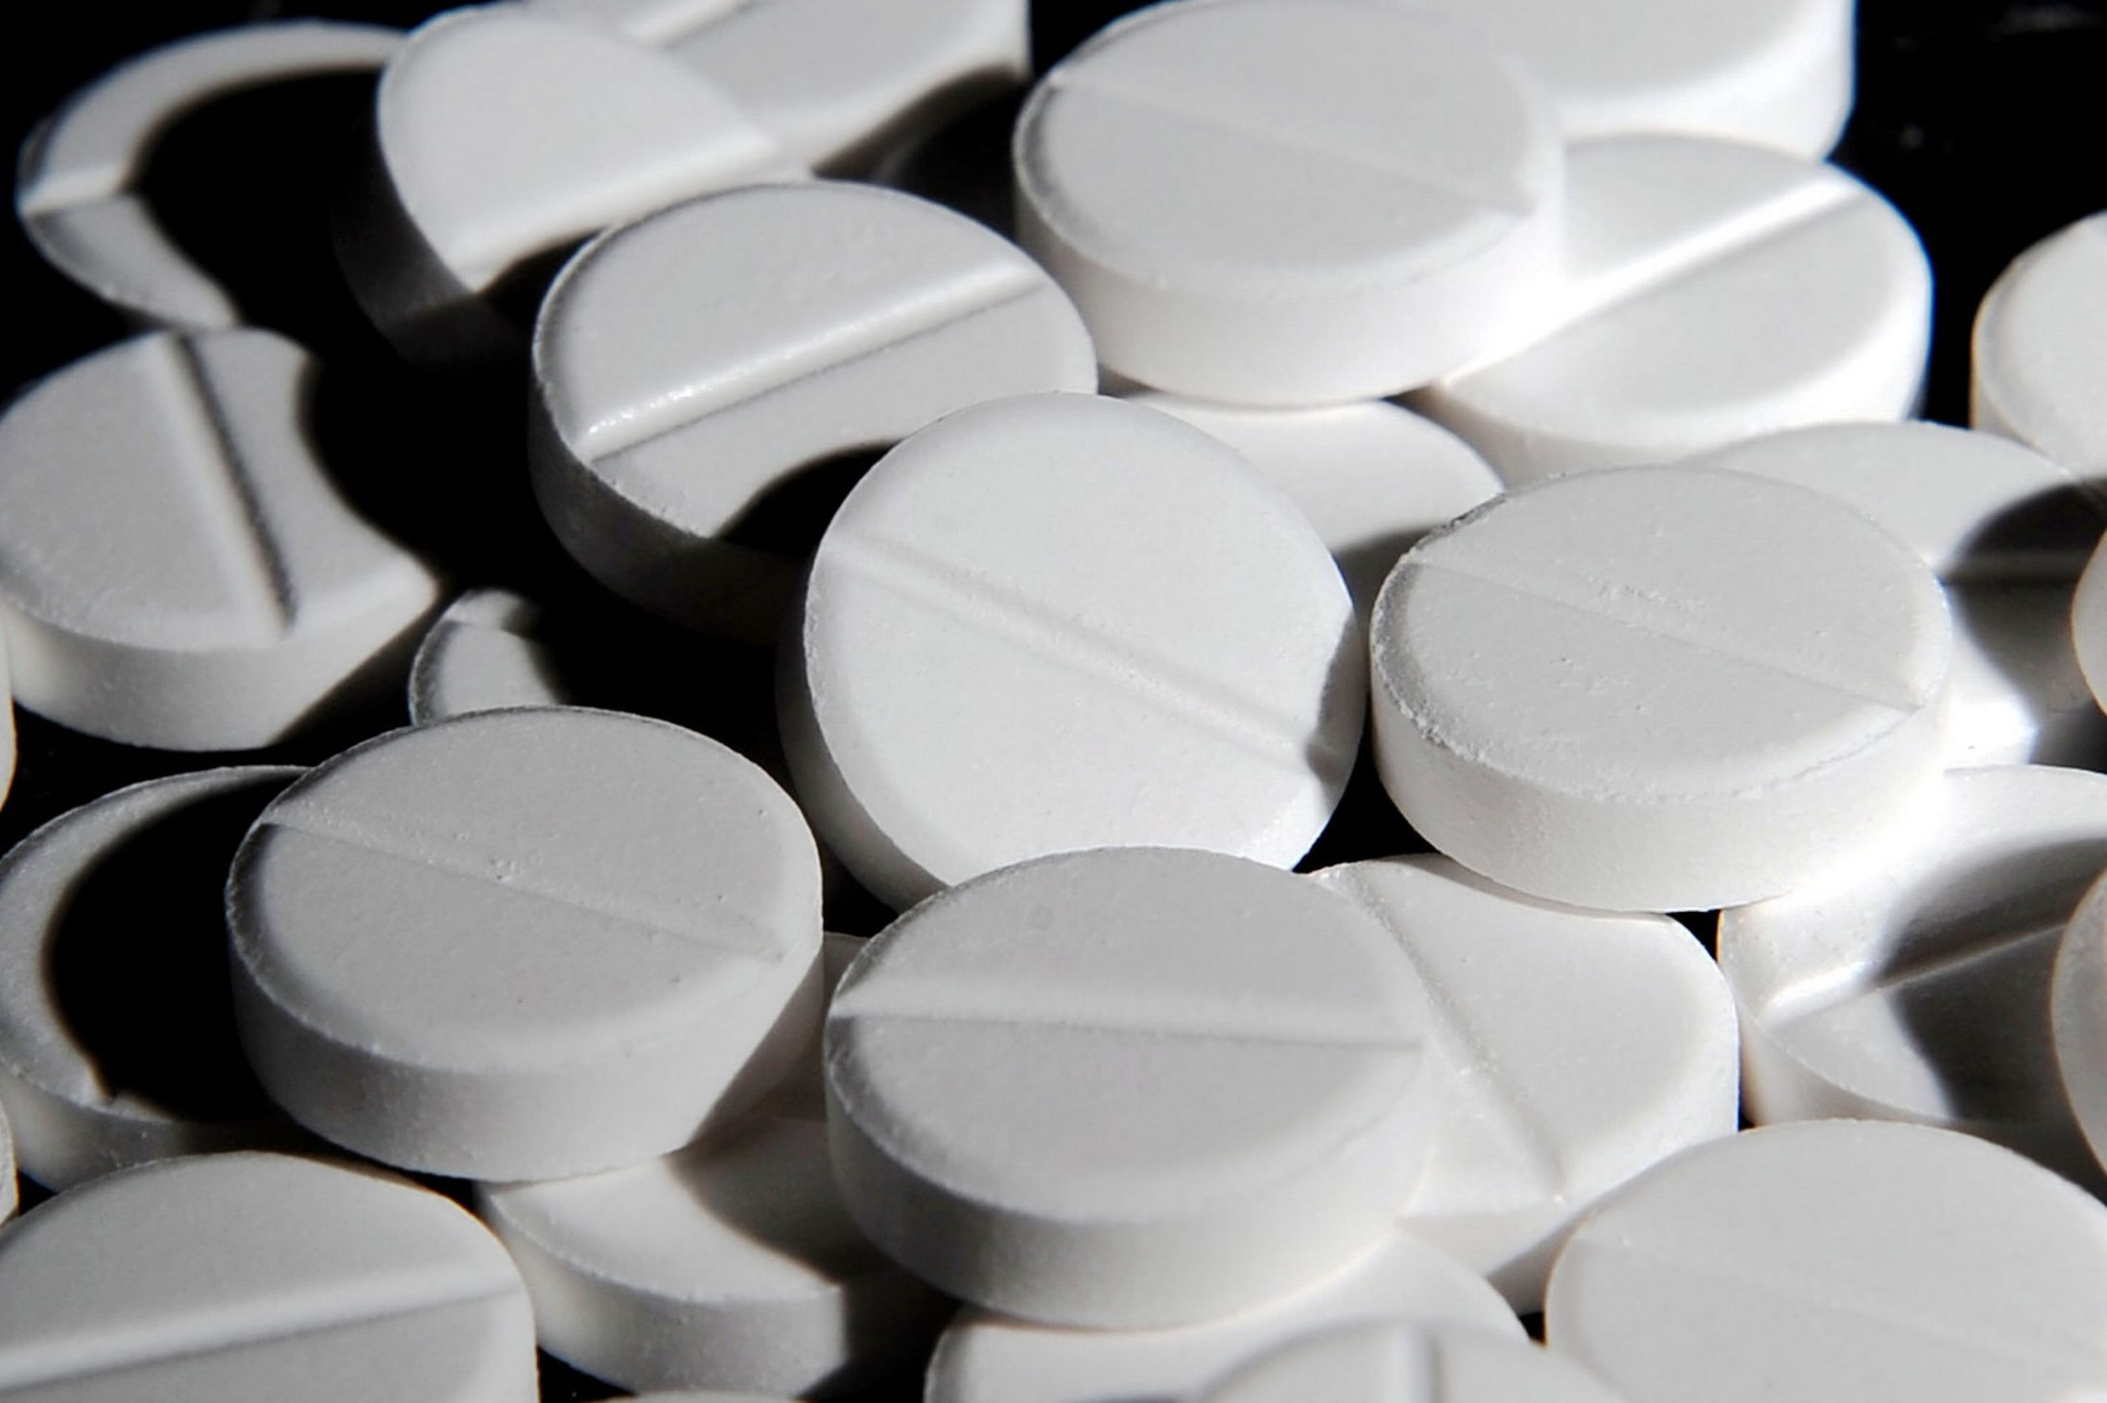
Management
Depends on
-amount ingested
-timing

Slide 35
Management
Reduce absorption
Gastric lavage
Activated charcoal
Only useful within 2 hours

Slide 36
Management
Antidote –N- acetylcysteine
Methionine
NAC-help replenish glutathione which convert NAPQI to less toxic form
act as a source of sulphate and facilitate the conjugation pathway of metabolism

Slide 37
Mechanism of action of NAC
Paracetamol
Glucouronide and sulphate
NAPQI
TOXIC
Excreted unchanged
Facilitates conjugation
Conjugation
NAC
Oxidation
CYP 450
Converted to non toxic substance by glutathione
Act as a source of glutathione

Slide 38
Management
When to give NAC?
-ingested >toxic dose
-or paracetamol levels above the treatment line when plotted in normogram
Ideally should start with in 8h of ingestion
Treatment started between 8-24h--- lowers mortality/incomplete protection from hepatotoxicity

Slide 39
Case 1
On further questioning the patient reveals that the 25 tablets were taken at 1 pm and the time when the doctor sees the patient is 7.30pm.
-Does this patient need an antidote ?
-What will be the other important aspects in management ?

Slide 40
Case 2
Ajith, a 34 year old driver is brought to the casualty ward of a Base hospital by his wife.
He has consumed 35 tablets of paracetamol 2 hours prior to admission.
He is a regular alcoholic but has not taken alcohol on the day of admission.
1.Would you consider gastric decontamination?
2.What are the investigations you would order on admission?
3. What is the importance of the patient being a chronic alchoholic?
4.Would you consider treating with an antidote? How will you give it?

Slide 41
NAC dosing
150 mg/kg over the first hour (200ml)
50 mg/kg over the next 4 hours(500ml)
100mg/kg over the next 16 hours(1000ml)
NAC may be diluted in 5% dextrose or 0.9% saline

Slide 42
Case 3
A 25 year old female is admitted 48 hours after ingestion of 35 tablets of paracetamol. She complains of abdominal pain
1.What are the important aspects in management?

Slide 43
Management of patients presenting >24h after
Paracetamol levels of no use
NAC is not routinely indicated and less effective
Start if derangement of liver functions(INR/AST) +/- clinical evidence of liver failure or elevated serum creatinine

Slide 44
On examination she has RHC tenderness and AST -1200u/l
ALT-1450 u/l
What is the possible complication?
How will you manage this patient ?

Slide 45
Paracetamol induced liver failure
Conventional management /Supportive care
NAC infusion
Liver transplant in acute fulminant liver failure

Slide 46
Poor Prognostic indicators after Paracetamol overdose
pH <7.30 or
INR >6.5 (PT >100 seconds) and serum creatinine >300 micromol/L (>3.4 mg/dL) in patients with grade 3 or 4 hepatic encephalopathy.

Slide 47
Thank you….

